Slide 1
Learning Objective
I will be able to derive the general form of an exponential equation
Success Criteria
At the end of the lesson, I will be able to:
use worded statements and a table of values to exemplify an exponential pattern of growth or decay;
derive the general form of an exponential equation in terms of starting value, rate and other transformations;
identify the asymptotic nature of exponential growth and decay and use this to sketch exponential functions; and
describe the tendencies of the dependent variable as the independent tends towards the infinities.

Slide 2
Exponential relationship
Lesson Relevance
What does it mean to be increase or decrease exponentially?
Exponential increase
compound interest
cell division
population increase
Exponential decrease
value of a car
radioactive decay
bacteria treated by antibiotics

Slide 3
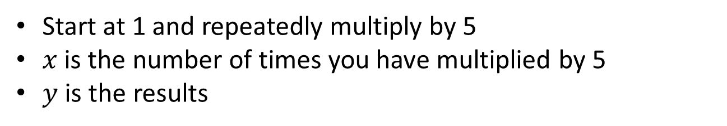
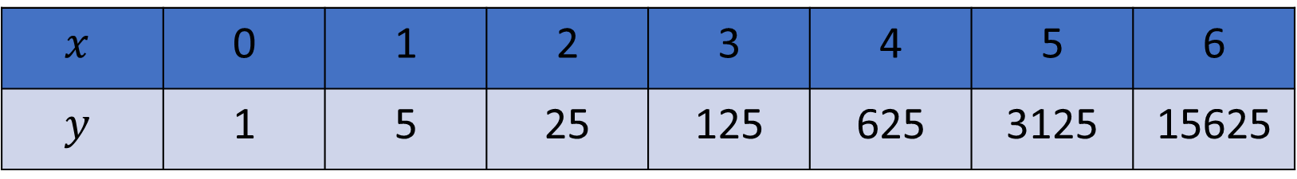
Concept Development
$$x$$ | 0 | 1 | 2 | 3 | 4 | 5 | 6
$$y$$ | 1 | 5 | 25 | 125 | 625 | 3125 | 15625
Can you identify the pattern?
Start at 1 and repeatedly multiply by 5
$x$ is the number of times you have multiplied by 5
$y$ is the results
Exponential relationship
A relationship between two variables is said to be exponential if there exists a common ratio between the values of dependent variable.

Slide 4

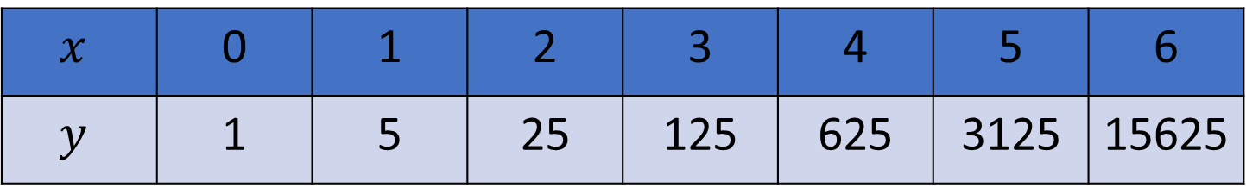
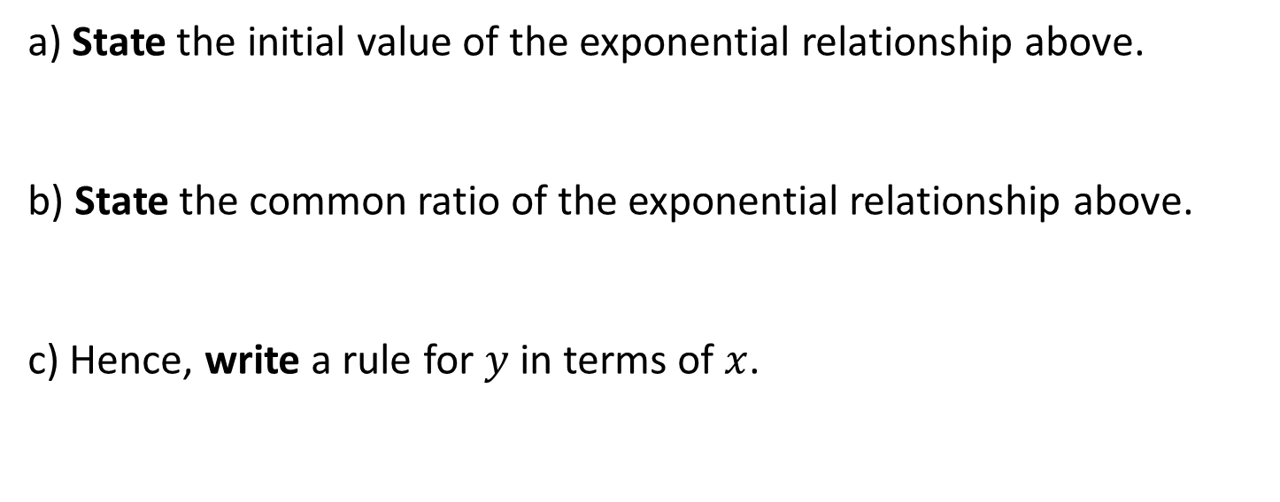

Concept Development
$$x$$ | 0 | 1 | 2 | 3 | 4 | 5 | 6
$$y$$ | 1 | 5 | 25 | 125 | 625 | 3125 | 15625
a) State the initial value of the exponential relationship above.
b) State the common ratio of the exponential relationship above.
c) Hence, write a rule for $y$ in terms of $x$.
1
5
$$y=5^{x}$$
$$y={1∙5}^{x}$$

Slide 5

Exponential Relationship
Concept Development
General rule:
$$y=a∙r^{x}$$
$a$ is the initial value (i.e. y-intercept)
$r$ is the common ratio ($r>0, r≠1)$

Slide 6
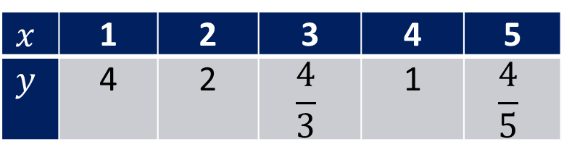
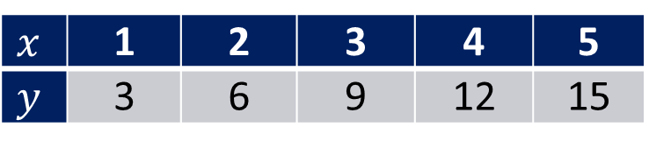
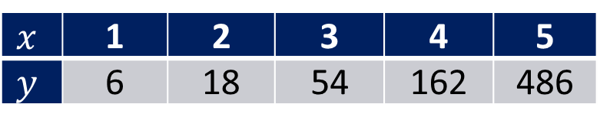
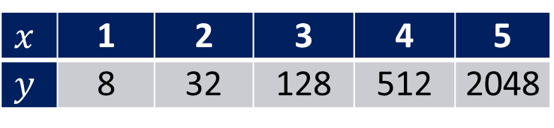
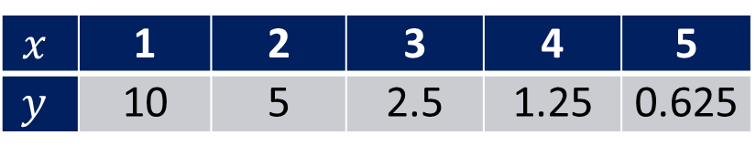

Guided Practice
Decide whether or not the following tables of values represent exponential relationships. If exponential, determine the rule for the relationship. If not exponential, state the type of relationship.
$$x$$ | 1 | 2 | 3 | 4 | 5
$$y$$ | 4 | 1 | 0 | 1 | 4
$$x$$ | 1 | 2 | 3 | 4 | 5
$$y$$ | 6 | 18 | 54 | 162 | 486
$$x$$ | 1 | 2 | 3 | 4 | 5
$$y$$ | 3 | 6 | 9 | 12 | 15
$$x$$ | 1 | 2 | 3 | 4 | 5
$$y$$ | 4 | 2 | $$\frac{4}{3}$$ | 1 | $$\frac{4}{5}$$
$$x$$ | 1 | 2 | 3 | 4 | 5
$$y$$ | 8 | 32 | 128 | 512 | 2048
$$x$$ | 1 | 2 | 3 | 4 | 5
$$y$$ | 10 | 5 | 2.5 | 1.25 | 0.625

Slide 7
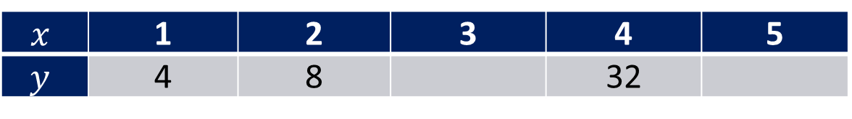
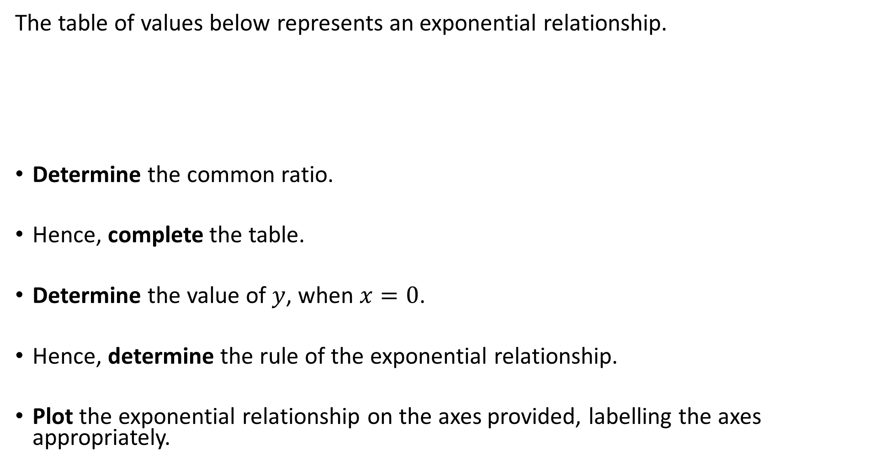
Guided Practice
The table of values below represents an exponential relationship.
Determine the common ratio.
Hence, complete the table.
Determine the value of $y$, when $x=0$.
Hence, determine the rule of the exponential relationship.
Plot the exponential relationship on the axes provided, labelling the axes appropriately.
$$x$$ | 1 | 2 | 3 | 4 | 5
$$y$$ | 4 | 8 |  | 32

Slide 8
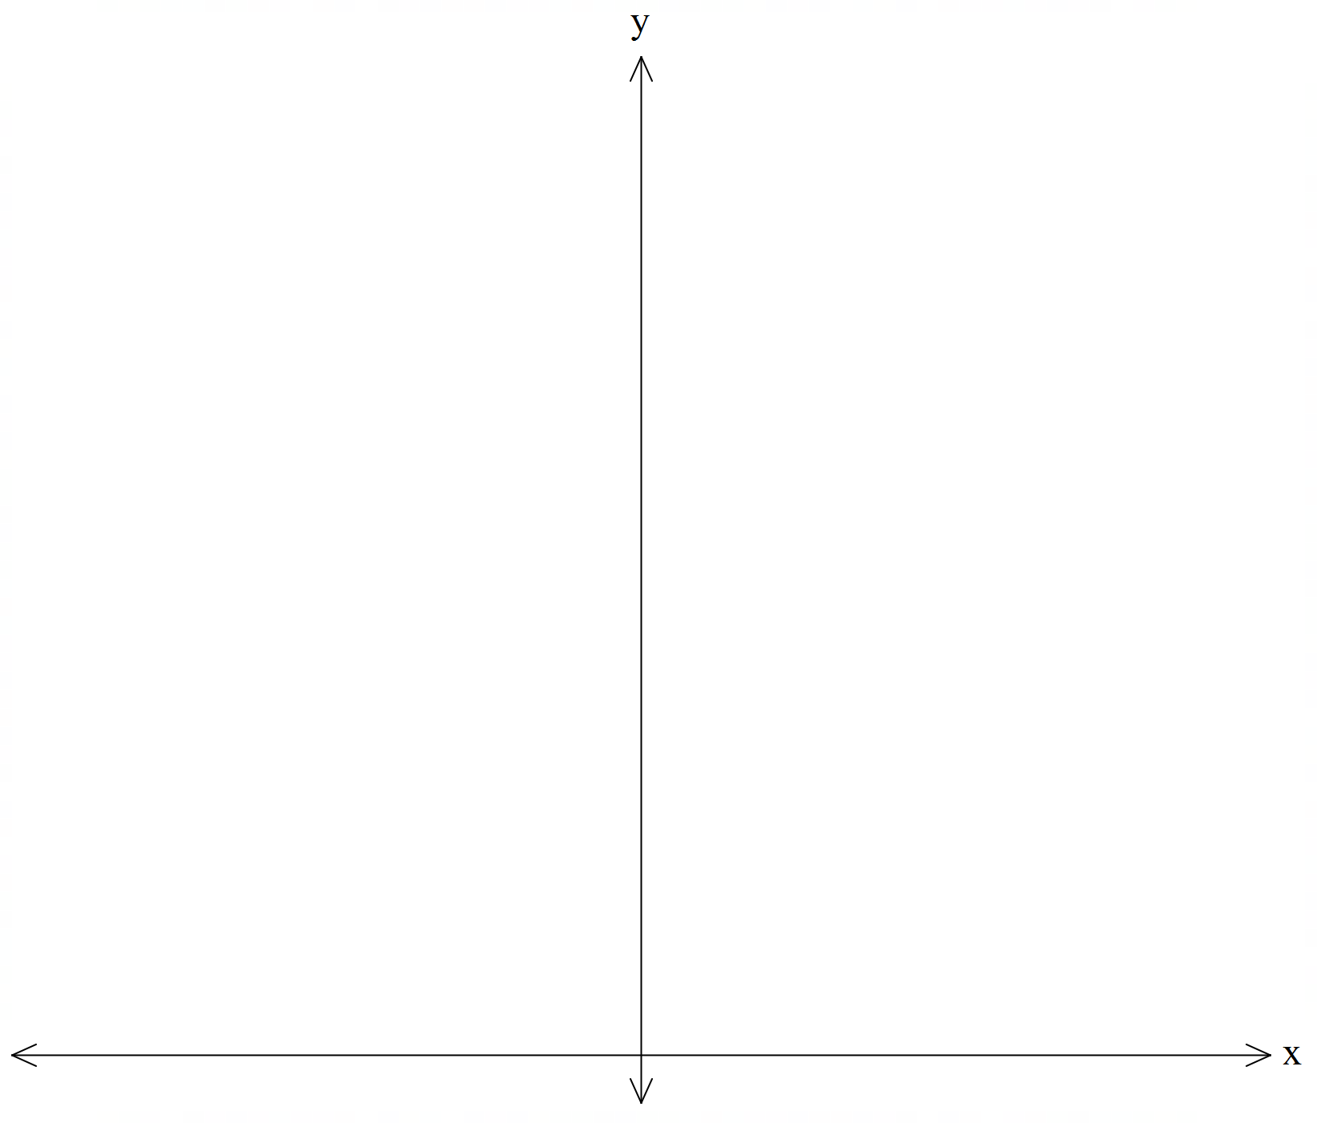
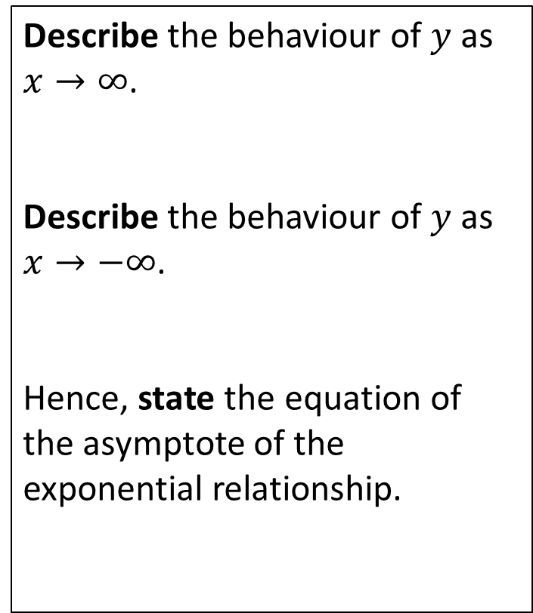
Guided Practice
Describe the behaviour of $y$ as $x→∞$.
Describe the behaviour of $y$ as $x→−∞$.
Hence, state the equation of the asymptote of the exponential relationship.
Asymptote y = 0 (x-axis)

Slide 9
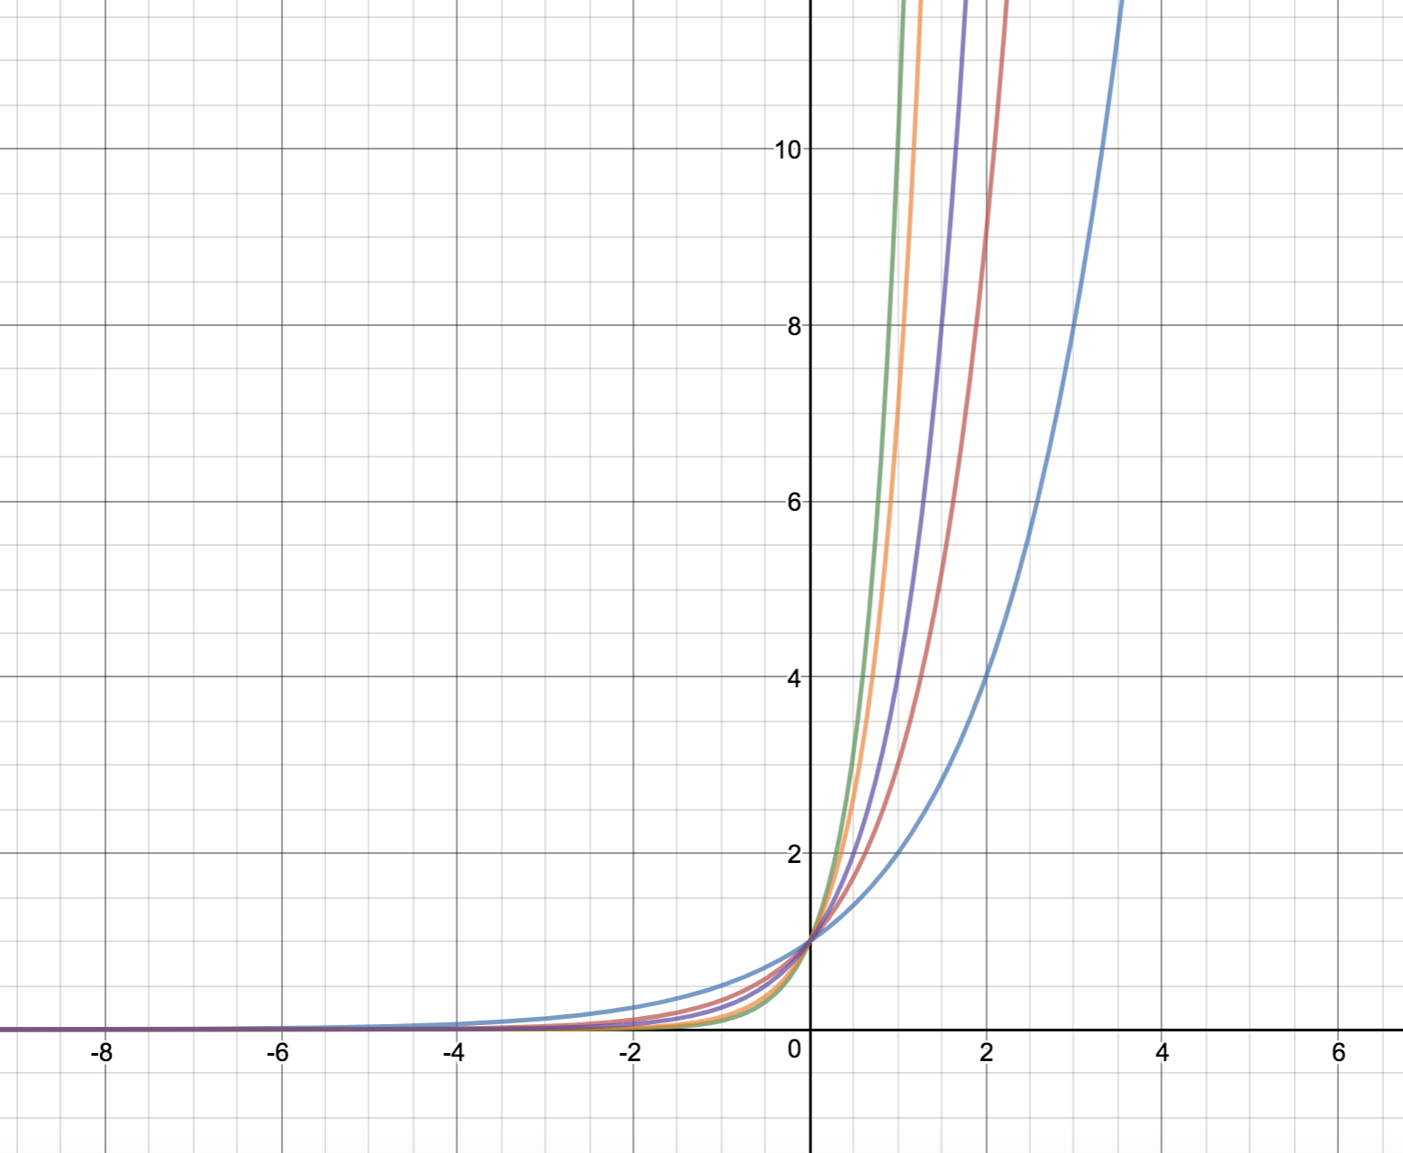
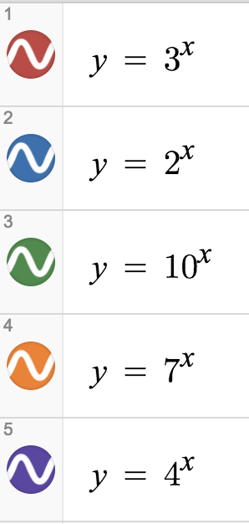
Asymptote y = 0 (x-axis)

Slide 10
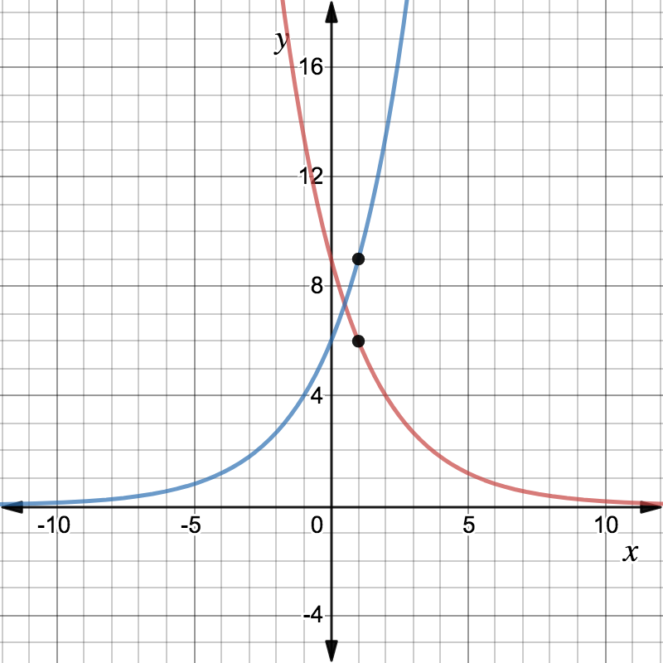
Determine the equation of the following exponential functions.

Slide 11
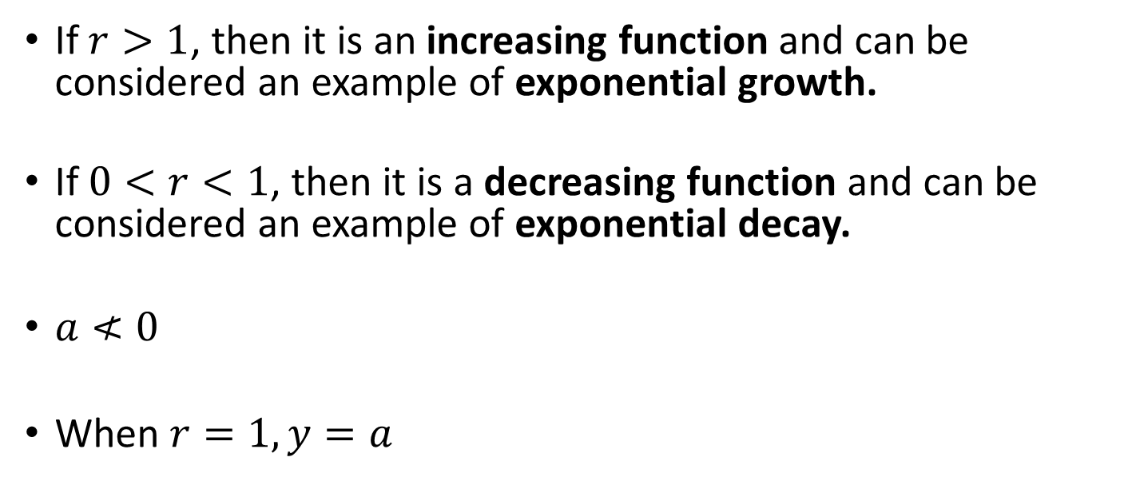

$$y=a∙r^{x}$$
Concept Development
If $r>1$, then it is an increasing function and can be considered an example of exponential growth.
If $0<r<1$, then it is a decreasing function and can be considered an example of exponential decay.
$a≮0$
When $r=1, y=a$

Slide 12
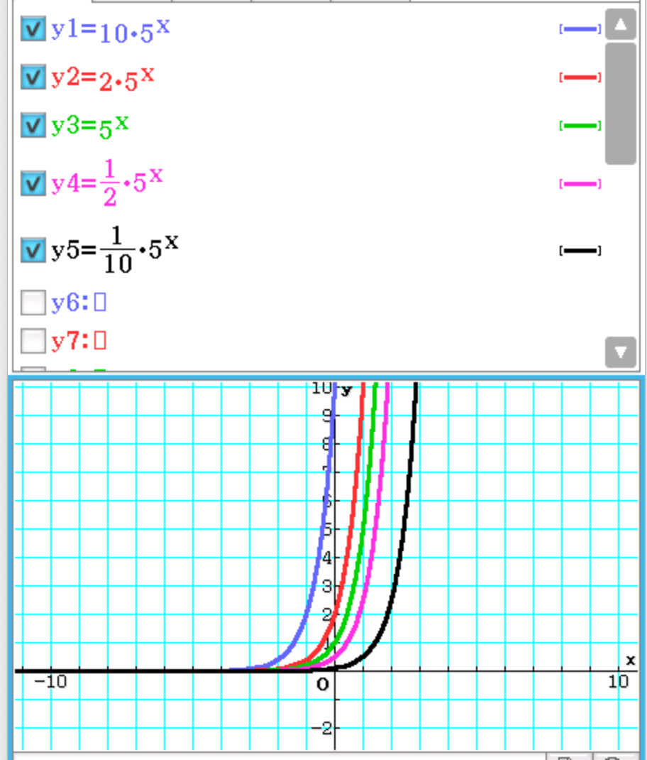

Use your classpad to plot
$y=10⋅5^{x}$
$y=2⋅5^{x}$
$y=5^{x}$
$y=\frac{1}{2}⋅5^{x}$
$y=\frac{1}{10}⋅5^{x}$

Slide 13
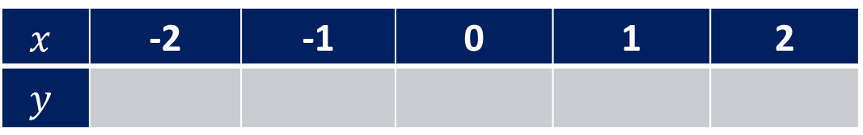
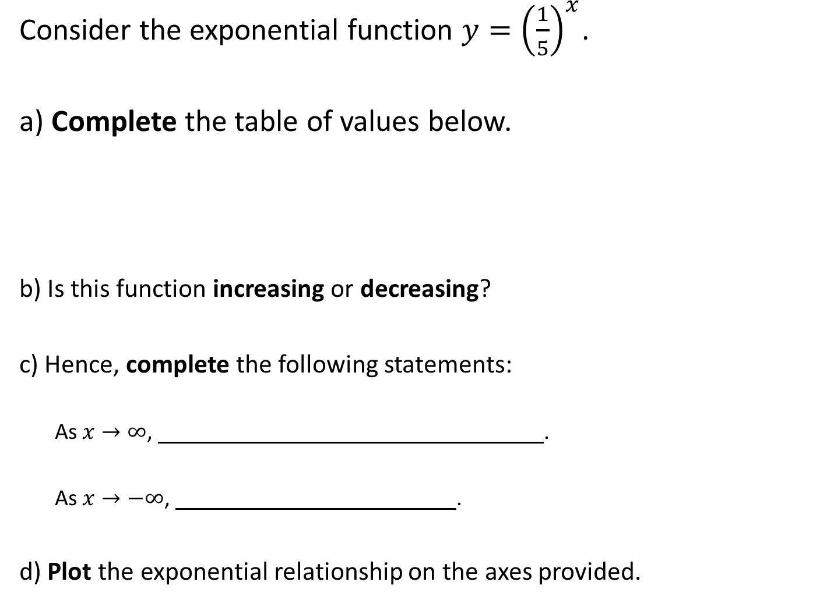
Guided Practice
Consider the exponential function $y={\left(\frac{1}{5}\right)}^{x}$.
a) Complete the table of values below.
b) Is this function increasing or decreasing?
c) Hence, complete the following statements:
As $x→∞$, .
As $x→−∞$, .
d) Plot the exponential relationship on the axes provided.
$$x$$ | -2 | -1 | 0 | 1 | 2
$$y$$

Slide 14
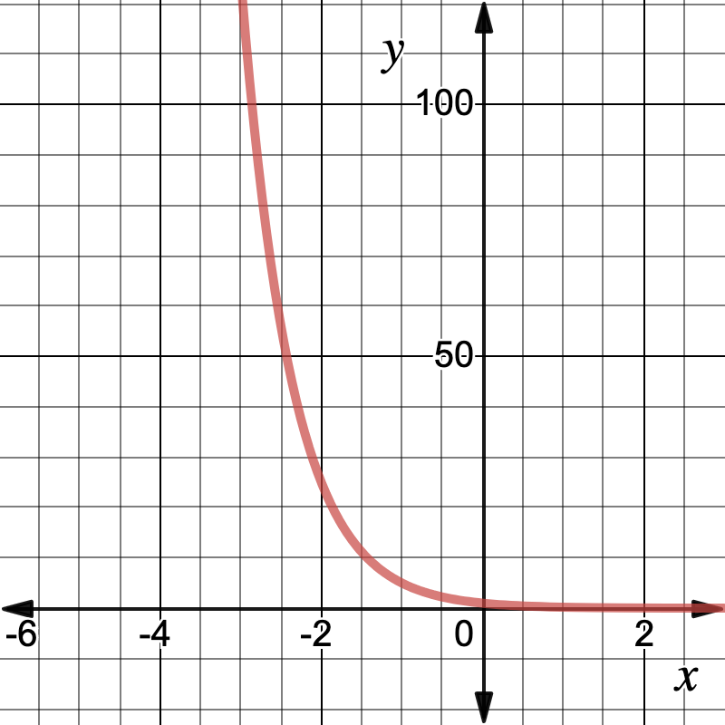

Guided Practice
$$y= {\left(\frac{1}{5}\right)}^{x}$$
Asymptote y = 0 (x-axis)

Slide 15
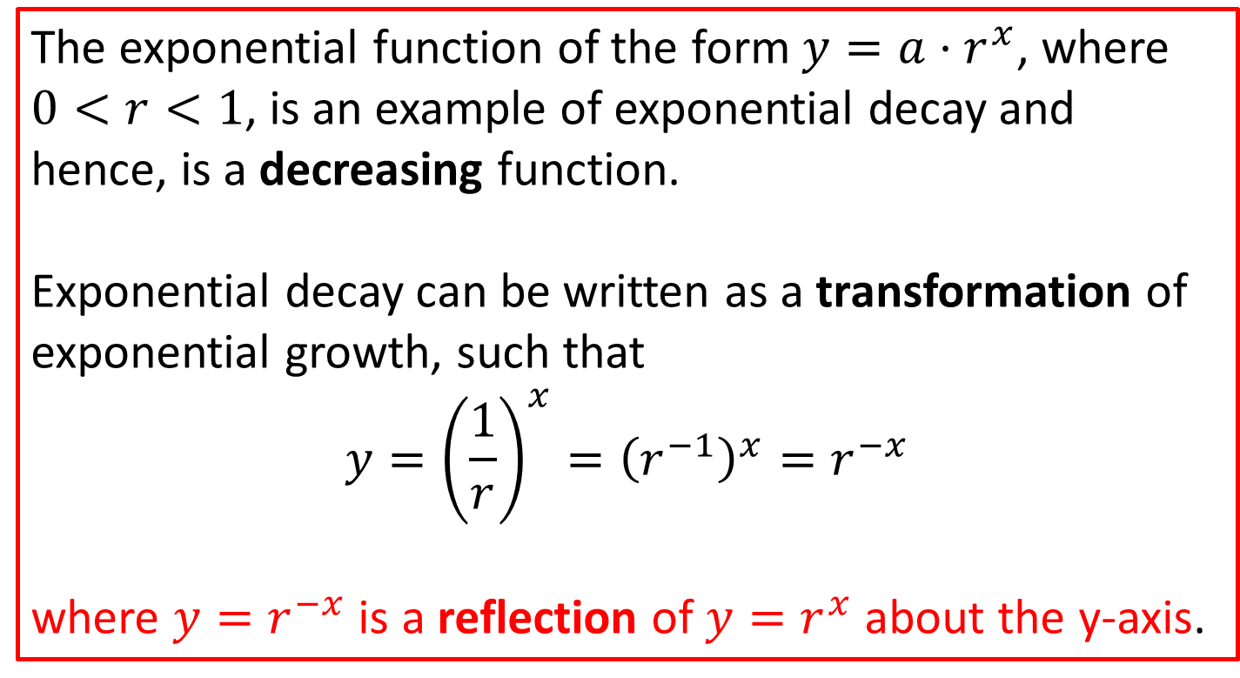

How else can $\frac{1}{5}$ be written?
Hence how else can $y={\left(\frac{1}{5}\right)}^{x}$ be written?
The exponential function of the form $y=a⋅r^{x}$, where $0<r<1$, is an example of exponential decay and hence, is a decreasing function.
Exponential decay can be written as a transformation of exponential growth, such that $$y={\left(\frac{1}{r}\right)}^{x}={\left(r^{−1}\right)}^{x}=r^{−x}$$
where $y=r^{−x}$ is a reflection of $y=r^{x}$ about the y-axis.

Slide 16
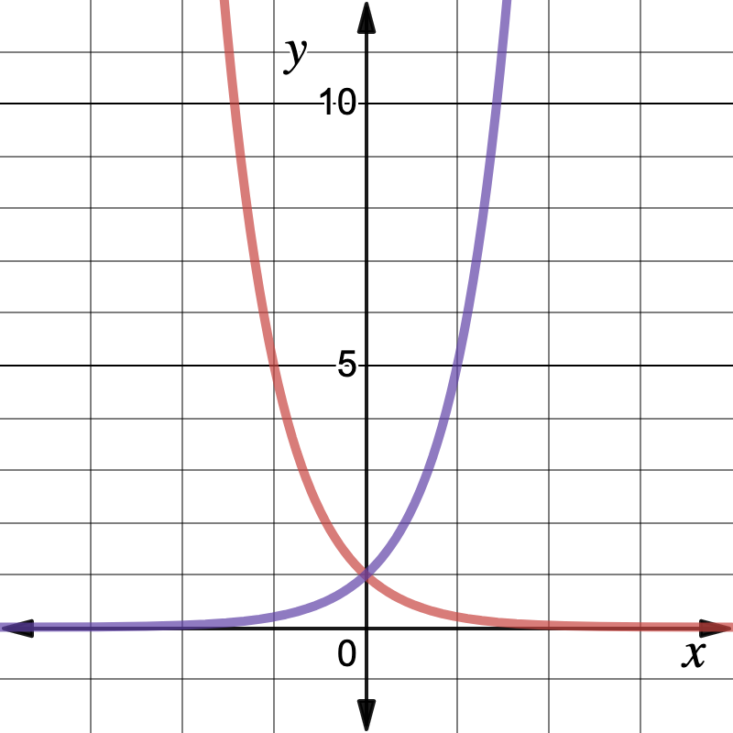


$$y= {\left(\frac{1}{5}\right)}^{x}$$
$$y= 5^{x}$$

Slide 17
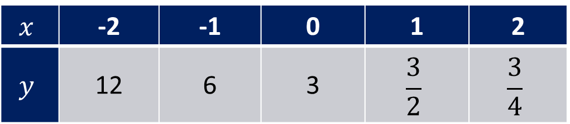
Guided Practice
Determine the equation of the exponential function defined by the following table of values, expressing your answer in two different forms.
$$x$$ | -2 | -1 | 0 | 1 | 2
$$y$$ | 12 | 6 | 3 | $$\frac{3}{2}$$ | $$\frac{3}{4}$$

Slide 18
Independent Practice
Complete Sadler Unit 2 Ex 2A

